Slide 1
Online Profiles Opinions, Inference, Perception
Elena Agapie
Qualifying Exam, Dec 2011

Slide 2
How to disseminate relevant information to relevant people

Slide 3
The online world today

Slide 4
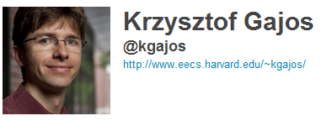
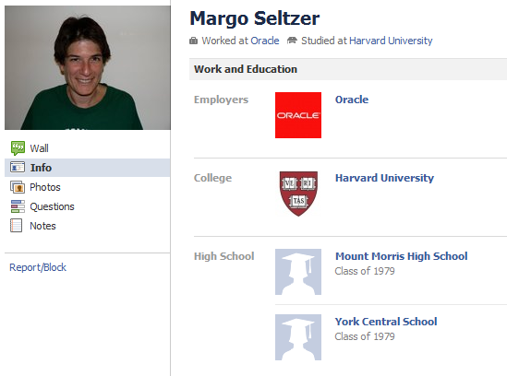
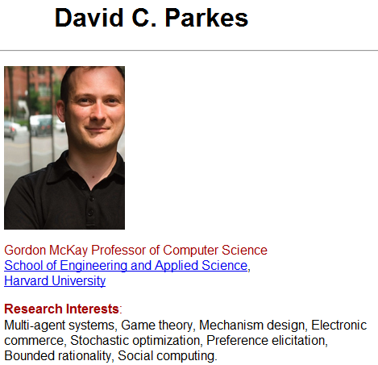
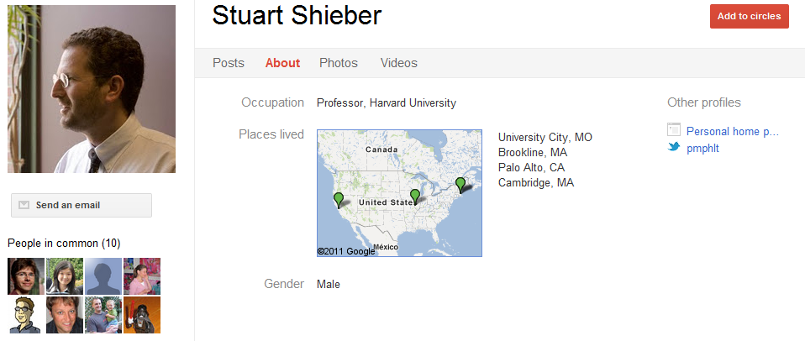
Profiles Online

Slide 5
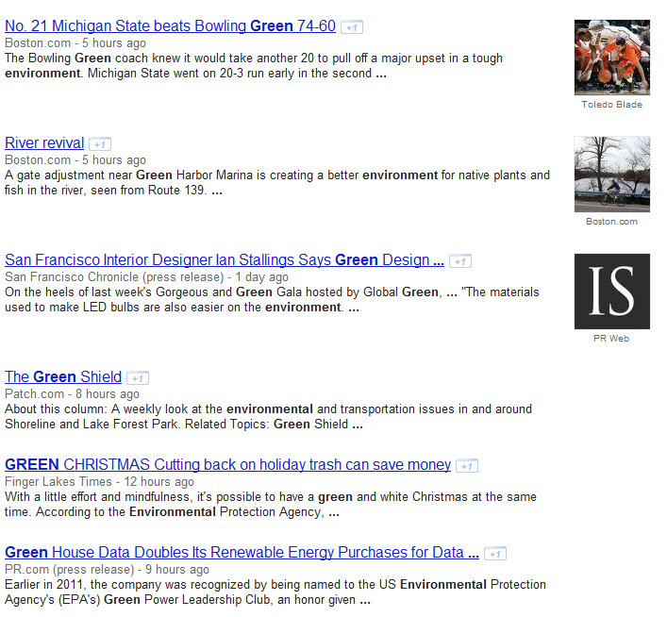
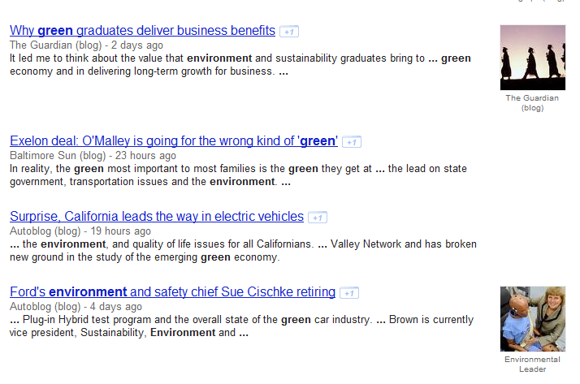
News Aggregators

Slide 6
Individual Profiles are Important for News Delivery

Slide 7
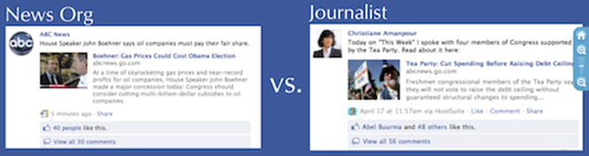
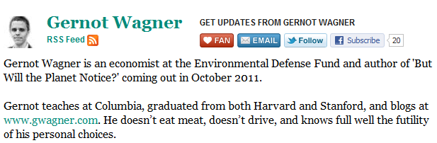
Online Profiles in the News Space

Slide 8
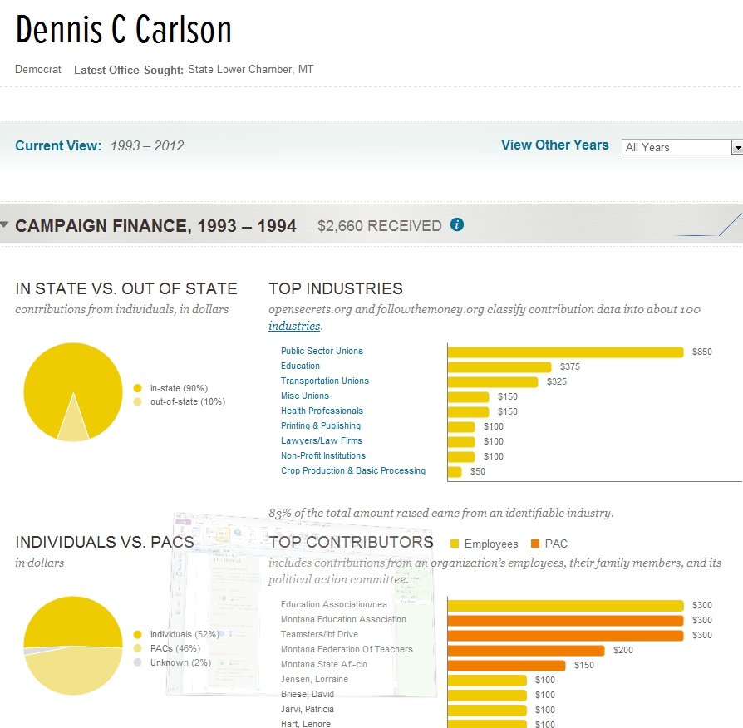
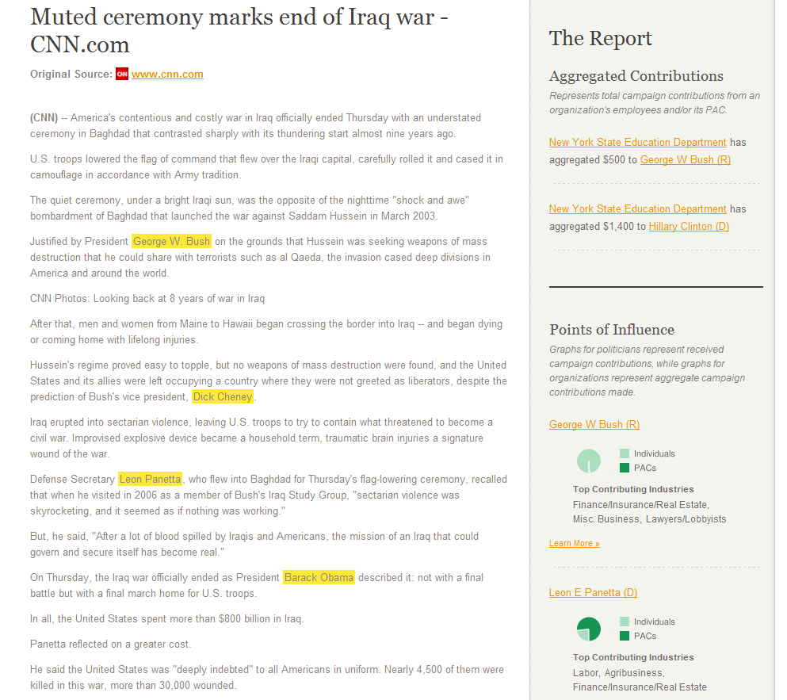
Online Profiles in the News Space
www.poligraft.com

Slide 9
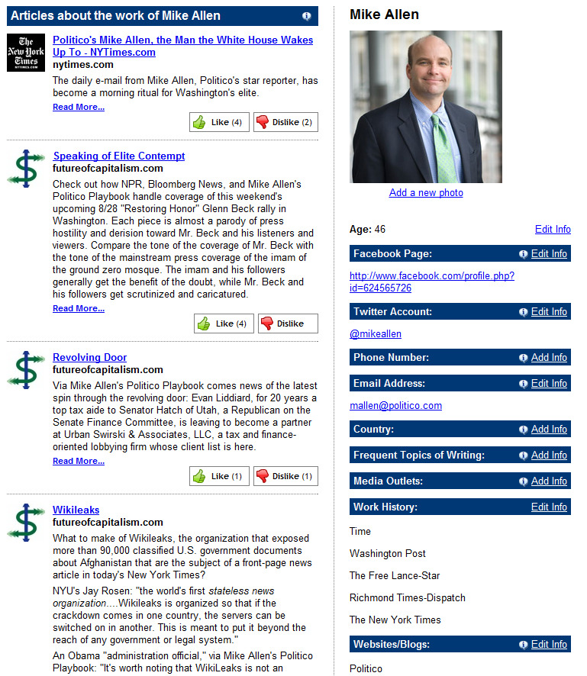
Author Profiles
www.newstransparency.com
(journalist profile wiki)

Slide 10
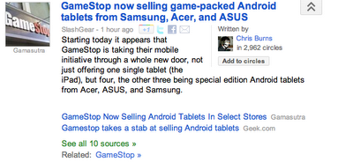
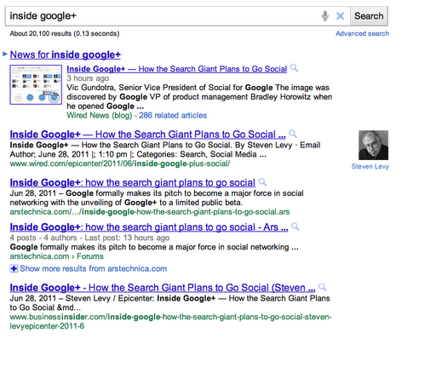
Author Profiles

Slide 11
Tomorrow’s World

Slide 12
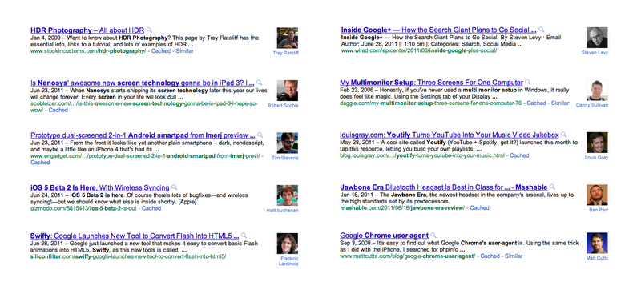

Slide 13
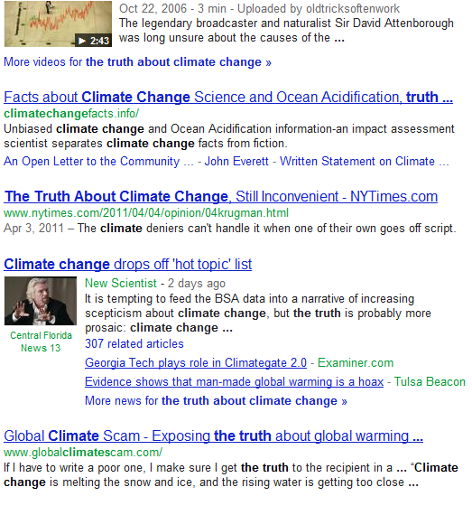


Slide 14
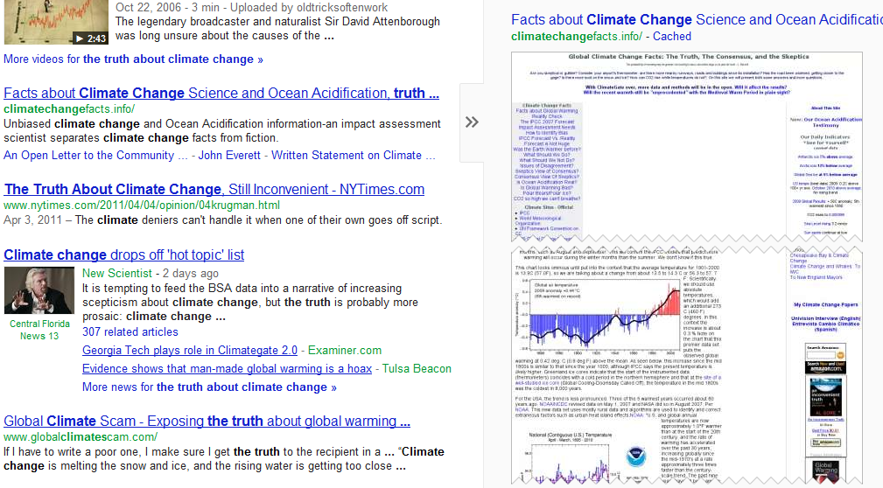
Preview Web Pages

Slide 15
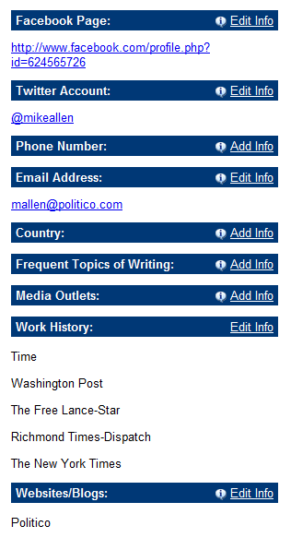

Slide 16
Opinions about climate change
Environment organization
Environment related organizations

Slide 17
Facebook likes:
Gay & Lesbian Victory Fund
Green Bay Packers
Working for Green
Documenting GLBT Boston
MEET (Middle East Education through Technology)

Slide 18
Filter Results based on Opinions of Author

Slide 19
Filter Results based on Opinions of Author
Domain Specific

Slide 20
Why News?

Slide 21
To Provide Diverse Content from Sources that Readers Will Listen To

Slide 22

User’s opinions and social views
Opinions about climate change
Environment organization
Environment related organizations
Social and Political Views

Slide 23
User’s opinions and social views
Charities they donate to:
Foundation for Support of Drug Users
Towards Reforming Marijuana Laws
Renewable Energy Foundation

Slide 24
Outline
Goal
Related work
Experiments
Future work

Slide 25


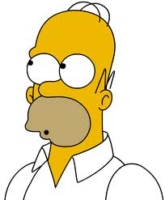
Provide a Flow Between Profiles, Machines, Reader and Author
What are her world views?
What are his world views?
Author
Profile 1
Article: Opinion: Opposing
Reader
Profile
Author
Profile
Article: Opinion Opposing

Slide 26
Provide a Flow Between Profiles, Machines, Reader and Author
What are her world views?
What are his world views?
Author
Profile 1
Article: Opinion: Opposing
Reader
Profile
Author
Profile
Article: Opinion Opposing

Slide 27
Research Question (part 1 of 3)
A way to reveal and infer opinions through online profiles
What are her views?
What Goes in This Profile?
Experiment 1
Notes:
Characterize opinion through a profile in a sensible way

Slide 28
Research Question (part 2 of 3)
How do readers perceive information from these profiles?
What are her views?
Experiment 2

Slide 29


Research Question (part 3 of 3)
Do profiles we relate to affect how we perceive opinions we agree/don’t agree with?
gun control is necessary guns protect us

Slide 30
Research Question (part 3 of 3)
Do profiles we relate to affect how we perceive opinions we agree/don’t agree with?
gun control is necessary guns protect us

Slide 31
Outline
Goal
Related work
Experiments
Future work

Slide 32
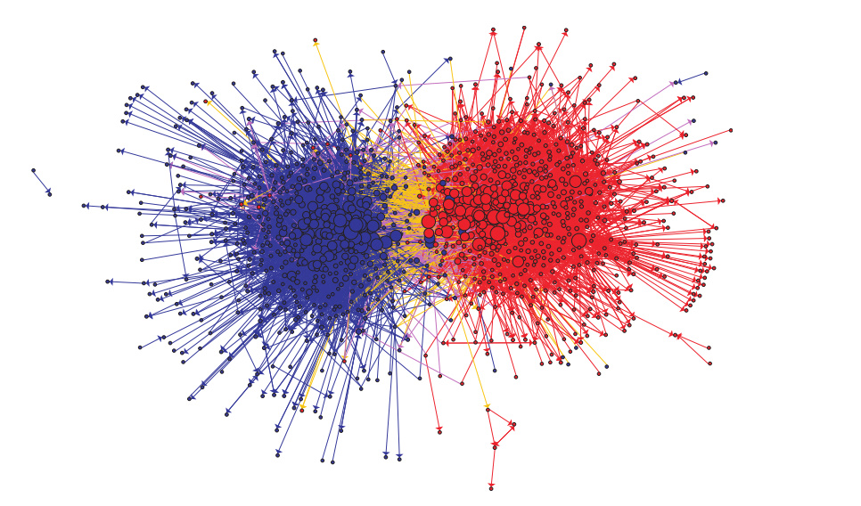
Polarization of Political Blogosphere
Adamic, Lada Glance, Natalie , The political blogosphere and the 2004 US election: divided they blog

Slide 33
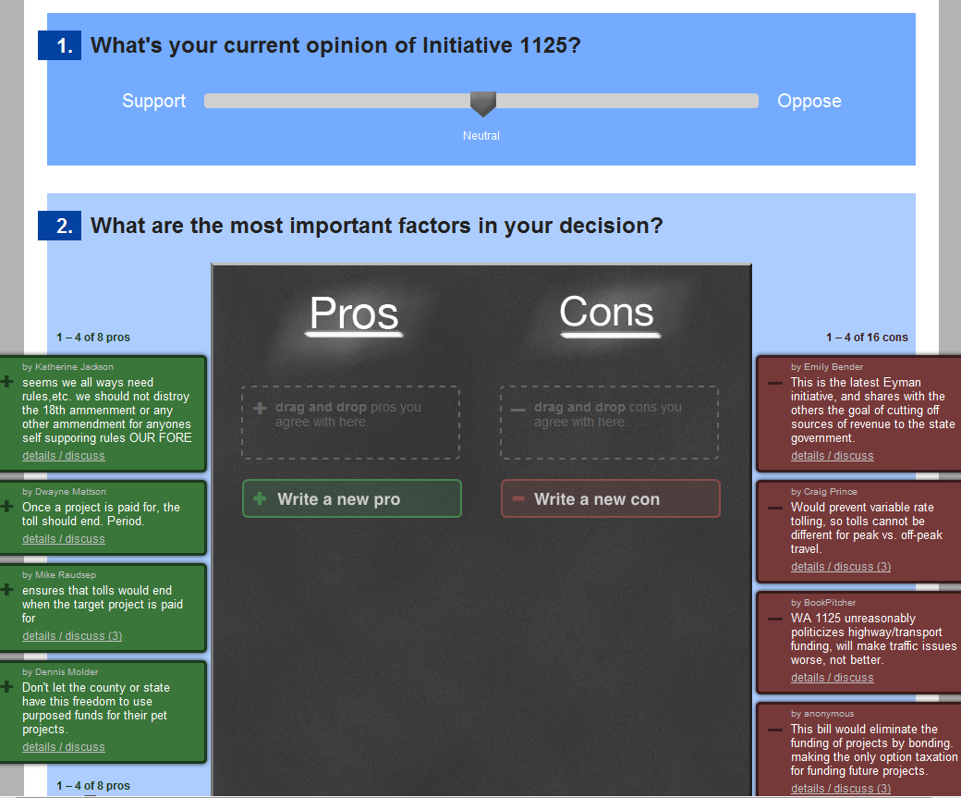
Diverse Opinions through Engagement
http://www.livingvotersguide.org/
ConsiderIt: Improving Structured Public Deliberation. Kriplean, T., Morgan, J. T., Freelon, D., Borning, A., Bennett, L. Work in progress, CHI 2011

Slide 34
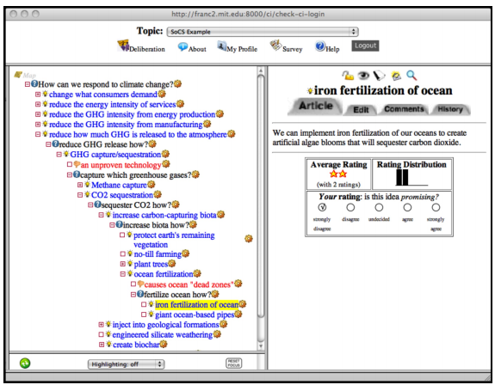
Diverse Opinions Through Argumentation
http://deliberatorium.mit.edu/
Supporting Collaborative Deliberation Using a Large-Scale Argumentation System: The MIT Collaboratorium. Proceedings of: Directions and Implications of Advanced Computing; Conference on Online Deliberation (DIAC-2008/OD2008). 2008.

Slide 35
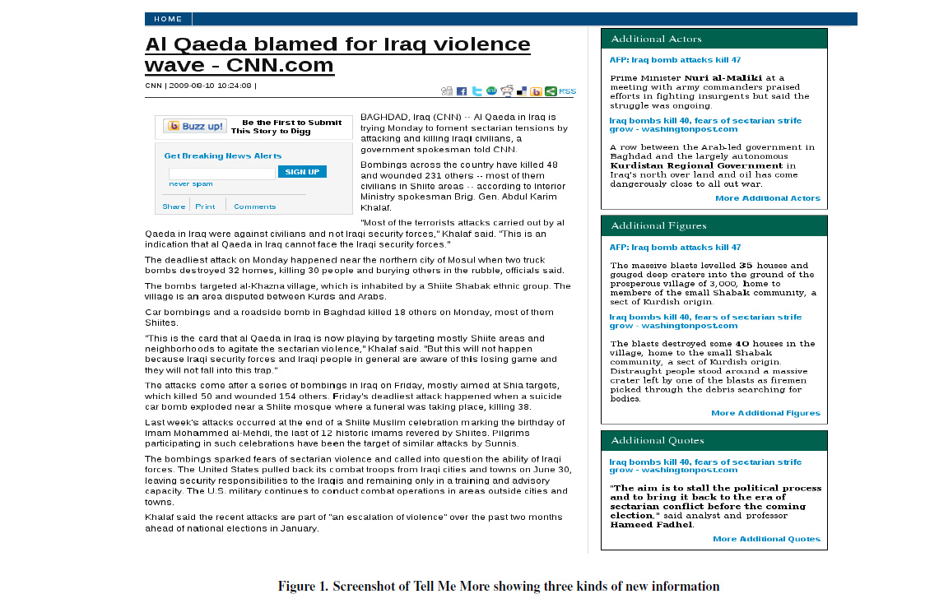
Related Work
Tell Me More,
Northwestern …

Slide 36
Related Work
Credibility of Source….

Slide 37
Identified Solutions to Make Diversity of Opinions Accessible

Slide 38
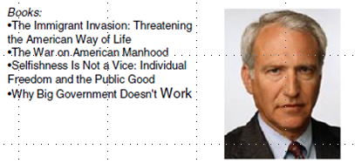
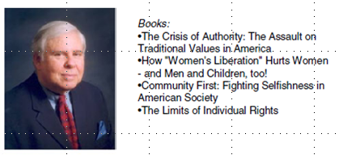
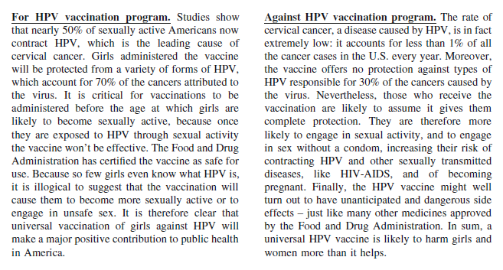
Profiles Influence Message Perception
Kahan, Dan M., Braman, Donald, Cohen, Geoffrey L., Slovic, Paul and Gastil, John, Who Fears the HPV Vaccine, Who Doesn't, and Why? An Experimental Study of the Mechanisms of Cultural Cognition (July 15, 2008). Law and Human Behavior, Vol. 34, pp. 501-16, 201

Slide 39
Profiles Influence Message Perception
Kahan, Dan M., Braman, Donald, Cohen, Geoffrey L., Slovic, Paul and Gastil, John, Who Fears the HPV Vaccine, Who Doesn't, and Why? An Experimental Study of the Mechanisms of Cultural Cognition (July 15, 2008). Law and Human Behavior, Vol. 34, pp. 501-16, 201

Slide 40
Profiles Influence Message Perception
Kahan, Dan M., Braman, Donald, Cohen, Geoffrey L., Slovic, Paul and Gastil, John, Who Fears the HPV Vaccine, Who Doesn't, and Why? An Experimental Study of the Mechanisms of Cultural Cognition (July 15, 2008). Law and Human Behavior, Vol. 34, pp. 501-16, 201

Slide 41
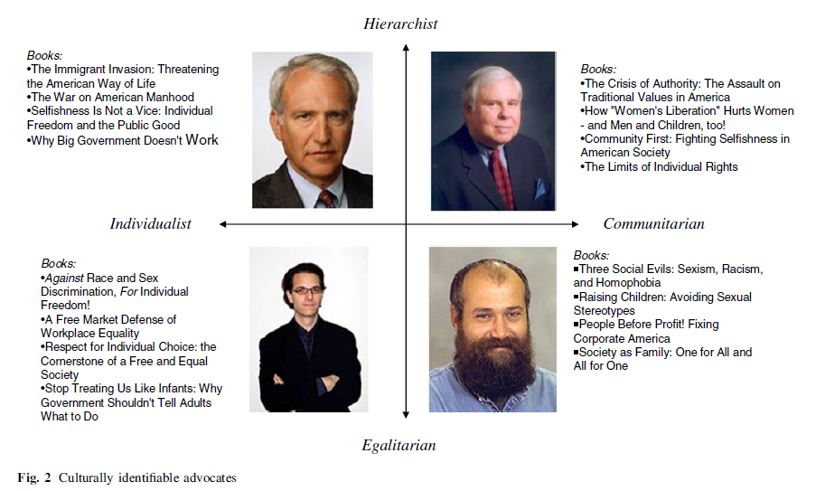
Kahan, Dan M., Braman, Donald, Cohen, Geoffrey L., Slovic, Paul and Gastil, John, Who Fears the HPV Vaccine, Who Doesn't, and Why? An Experimental Study of the Mechanisms of Cultural Cognition (July 15, 2008). Law and Human Behavior, Vol. 34, pp. 501-16, 201

Slide 42
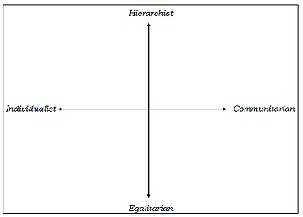
Cultural Theory (Mary Douglas)

Slide 43
Cultural Theory
Individualist – Communitarian
Preference towards individualistic vs social ordering
Individual responsible for their own flourishing as opposed to collective provisioning

Slide 44
Cultural Theory
Hierarchical – Egalitarian
Preference for stratified social ordering
Entitlements to goods correspond to forms of social differentiation, as opposed to the egalitarian, where the distribution of goods is equal

Slide 45
Cultural Theory of Risk
People perceive risks related to society from the perspective of the cultural dimensions

Slide 46
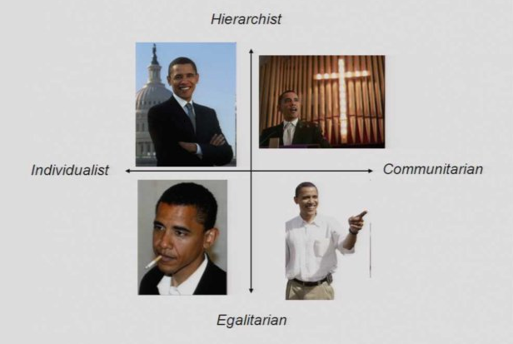
www.culturalcognition.net

Slide 47
Who the Author Is Impacts How We Perceive the Message
Notes:
Bring together CS systems , and soc sciences finding and build something that the hci looking at the content + the soc sciences looking at authorship

Slide 48
Cultural Cognition World View Survey
IINTRSTS. | The government interferes far too much in our everyday lives.
CHARM. | Sometimes government needs to make laws that keep people from hurting themselves.
IPROTECT | It's not the government's business to try to protect people from themselves.

Slide 49
How is the Cultural World View measured
HEQUAL. | We have gone too far in pushing equal rights in this country.
EWEALTH. | Our society would be better off if the distribution of wealth was more equal.
ERADEQ. | We need to dramatically reduce inequalities between the rich and the poor, whites and people of color, and men and women.

Slide 50
Outline
Problem Statement
Related work
Experiments
Future work

Slide 51
What are her world views?
What are her world views?
What is her profile?
Opinion
Experiment 1
Experiment 2
Inference
Perception
Notes:
Inference
perceptio

Slide 52
Experiment 1
Infer world views from profiles

Slide 53
Profile Information = Features
Profile Information
Learning Algorithm
Classifier
World Views = Labels
World Views

Slide 54
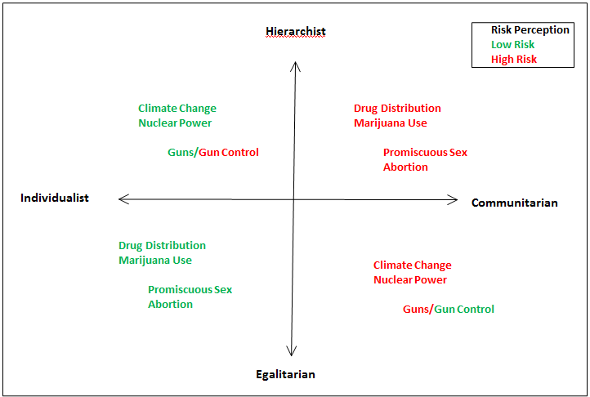
Selecting Features
How can online profiles of authors reveal their opinions?
Kahan D, Braman D, Slovic P, Gastil J, Cohen G, The Second National Risk and Culture Study: Making Sense of - and Making Progress In - The American Culture War of Fact (Oct 07). Yale Law School, Public Law Working Paper No. 154; Harvard Law School Program on Risk Regulation Research Paper No. 08-26.
Notes:
Feature selection

Slide 55
Selecting Features
How can online profiles of authors reveal their opinions?
Kahan D, Braman D, Slovic P, Gastil J, Cohen G, The Second National Risk and Culture Study: Making Sense of - and Making Progress In - The American Culture War of Fact (Oct 07). Yale Law School, Public Law Working Paper No. 154; Harvard Law School Program on Risk Regulation Research Paper No. 08-26.
Notes:
Feature selection

Slide 56
Constructing a Profile
=
Charity Donations

Slide 57
Topics – Feature Selection
GUNCONTROL/ GUNOWNER
NUCLEAR
CLIMATE
PROCHOICE (pro life)
MARIJUANA / MARIJUANAMEDICAL/DRUGDISTRIBUTION
GENTICALLY (modified foods)
INTERNET
GAYMARRIAGE

Slide 58
Topic | Charity 1 | Level | Charity 2 | Level
Climate Change | The Lies about Climate Change | L | Stop Climate Chaos/ Global Foundation for a Green Lifestyle | H
Nuclear Power | Renewable Energy Foundation | H | The Age of Nuclear Energy | L
Having the Pro Choice rigt | Pro Choice Action Group | L | Pro Life Charity | H
Having the Pro Life right | Pro Choice Action Group | H | Pro Life Charity | L
Legalization of marijuana use | Towards Reforming Marijuana Laws | L | Speaking Out Against the Legalization | H
Legalization of marijuana use for medical use | Organization for the Legalization of Medical Marijuana | L | Organization for Finding Alternative Medication Solutions | H

Slide 59
Question Types
I would donate to the following drugs related charity:
Towards Reforming Marijuana Laws
Speaking Out Against the Legalization
Similar:
Pro Choice Action Group / Pro Life Charity
Organization for the Supervision of Gun Ownership / Organization Against the Control of Guns by Governments

Slide 60
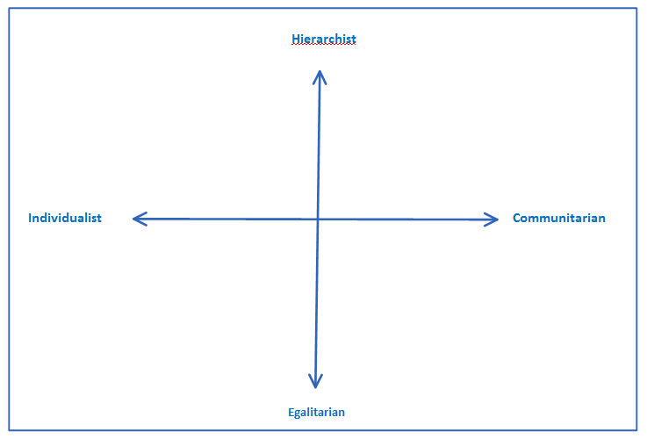
Experiment 1
Participant
Charity Donations
Survey
Survey World Views
Notes:
Change!!!!!!!!!!!!!!!!

Slide 61
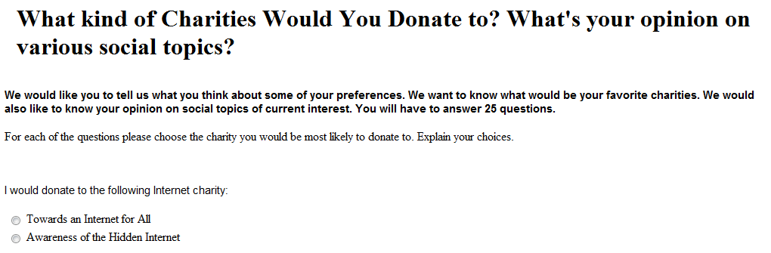
Experiment 1
Amazon Mechanical Turk (AMC) experiment

Slide 62
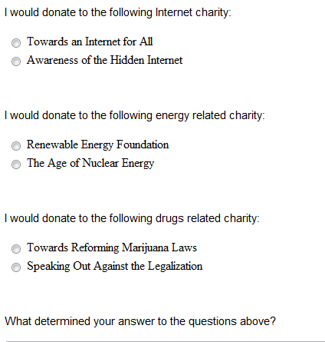
Experiment 1

Slide 63
Challenges
Filtering spammers
Filtering participants who didn’t pay attention
Make task “AMC” appropriate
Broke down in smaller steps

Slide 64
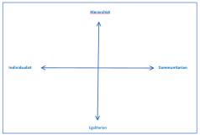
Results
What are her world views?
Charity Profile

Slide 65
Results
100 participant
22 discarded – lack of valid answers
AMC constraints:
US population only
95% approval rate
Notes:
Write about mturk qualification

Slide 66
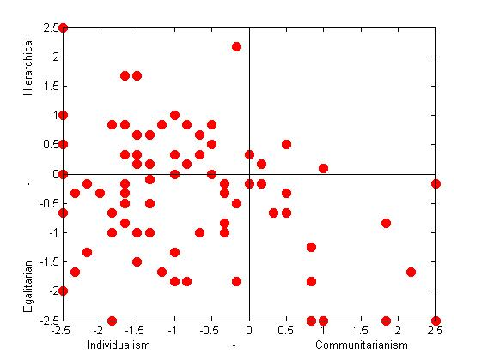
Cultural World View Survey

Slide 67
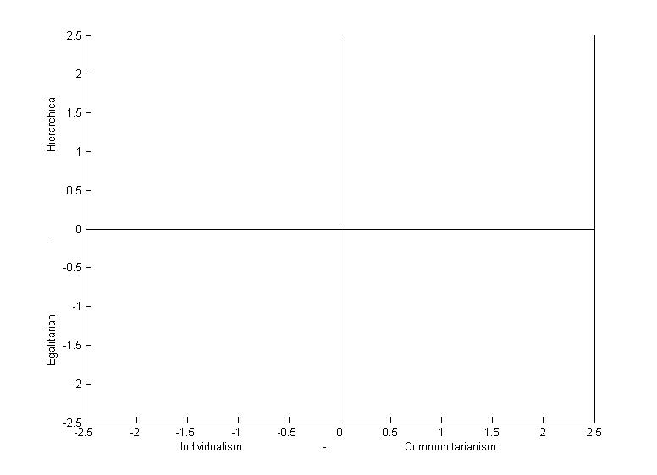
Cultural World View Survey
17%
3%
41%
30%

Slide 68
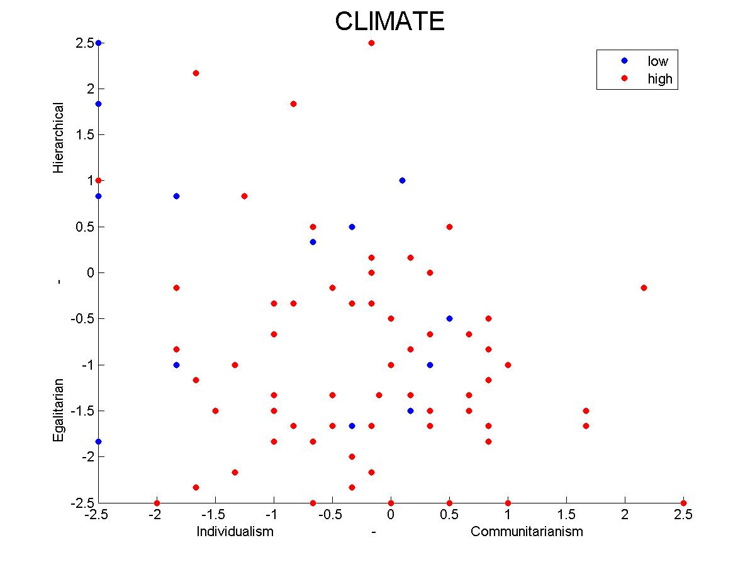
Results

Slide 69
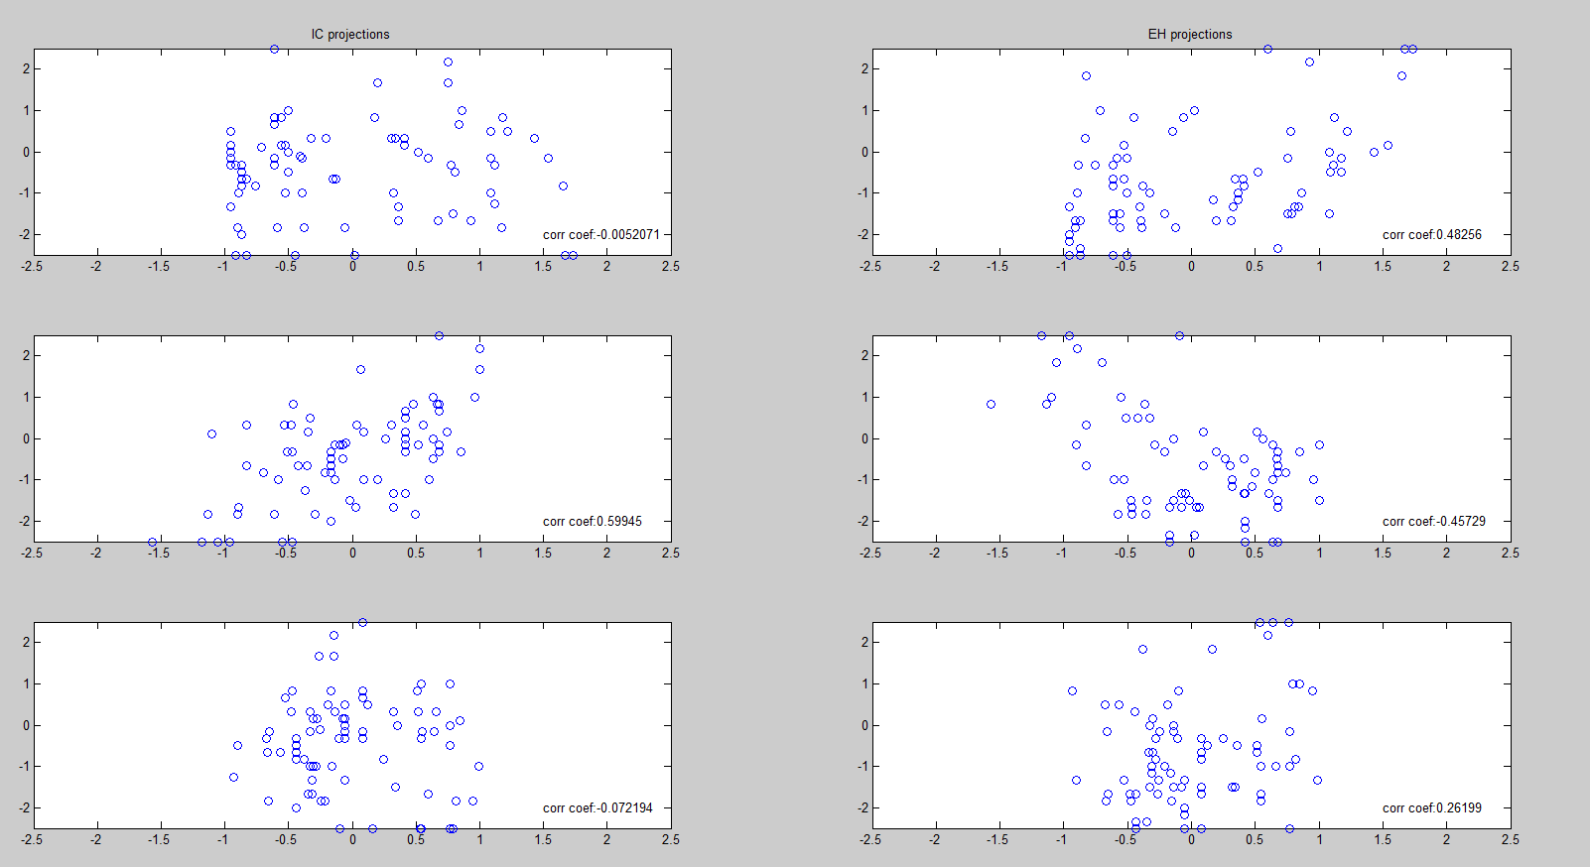
Projections of World Views on the Principal Components of Charities Data
Egalitarian-Hierachical
Individualist-Communitarian
PC1
PC2
PC3

Slide 70
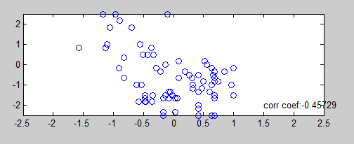
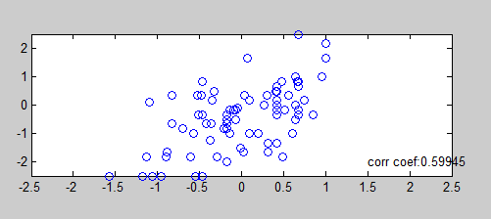
Projections of World Views on the 2nd Principal Components of Charities Data
EH score
Principal Component 2
IC score
Principal Component 2

Slide 71
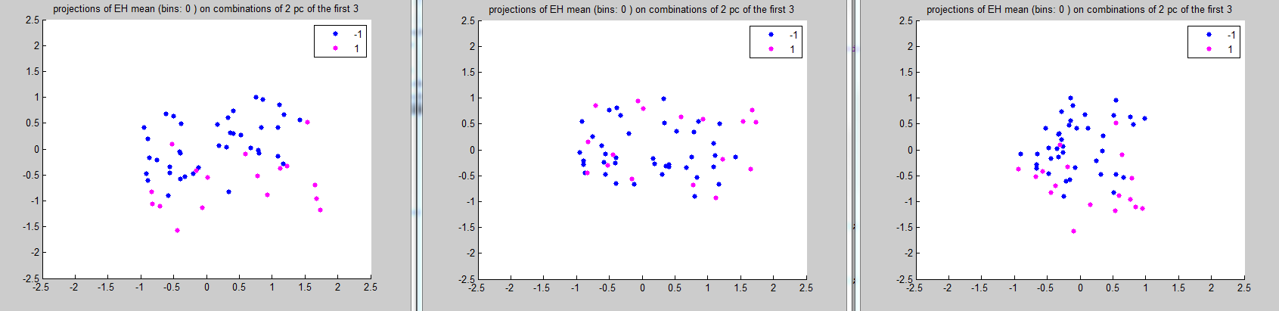
Results

Slide 72
PCA
Pc1 : gaymarriage, guncontrol, drugdistribution, marijuana, marijuanamedical, prochoice
Pc2: climate, gunowner, genetically
Feature Selection
drugdistrib, gunowner, nuclear,
Guncontrol, climate, internet, gunowner, nuclear,

Slide 73
Results
Variable | Classifier | Success Rate | Precision |  | Recall
Correct Quadrant | Naïve Bayes | 62% | IE | .65 | .52
 |  |  | IH | .58 | .71
 |  |  | EC | .63 | .72
 |  |  | HC | 0 | 0
Correct EH | Naïve Bayes | 87% | E | .89 | .95
 |  |  | H | .76 | .58
Correct IC | Naïve Bayes | 71% | I | .71 | .74
 |  |  | C | .57 | .51

Slide 74
Feature Selection
Feature Selection
Quadrant level
Gaymarriage, guncontrol, climate, internet, drugdistribution, gunowner, nuclear
EH dimension
Guncontrol, climate, internet, gunowner, nuclear
IC dimension
drugdistrib, gunowner, nuclear,
Notes:
greedy

Slide 75
Computers Can Infer World Views from Profiles

Slide 76
Experiment 2

Slide 77
What are her world views?
What are her world views?
Charity Profile
Experiment 1
Experiment 2

Slide 78
Experiment 2
Do people perceive world view from profiles?

Slide 79
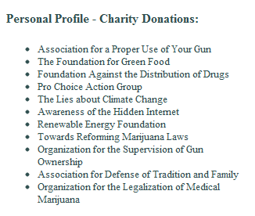
Experiment 2
What are her world views?

Slide 80
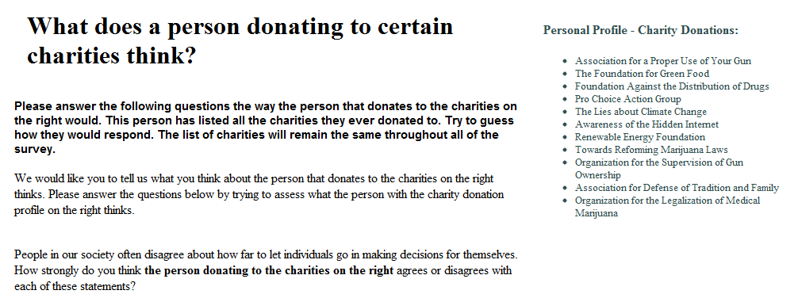
Experiment 2

Slide 81
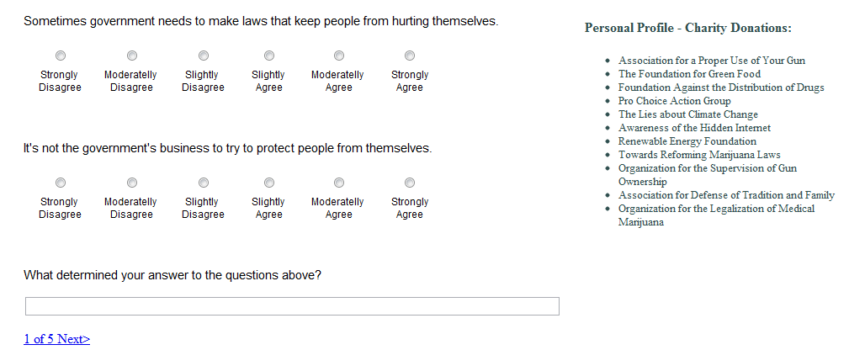
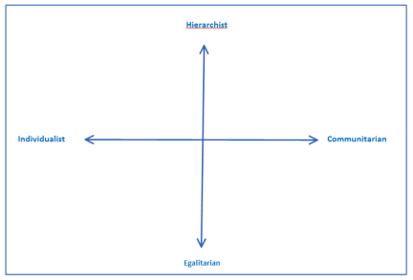
Experiment 2
Survey World Views
Charity Profile

Slide 82
Mean of std deviation of the estimates | 2.4939
Mean of the % of values estimated correctly on the EH axis | 0.7946
Mean of the % of values estimated correctly on the IC axis | 0.6458
Mean of % of values estimated correctly in the right quadrant | 0.4490
Mean of % of values estimated to be in quadrant HC | 0.0209
Mean of % of values estimated to be in quadrant EC | 0.2686
Mean of % of values estimated to be in quadrant IE | 0.4496
Mean of % of values estimated to be in quadrant HI | 0.2524
No of times the mean of the estimates was correct in EH | 2 of 9
No of times the mean of the estimates was correct in IC | 6 of 9

Slide 83
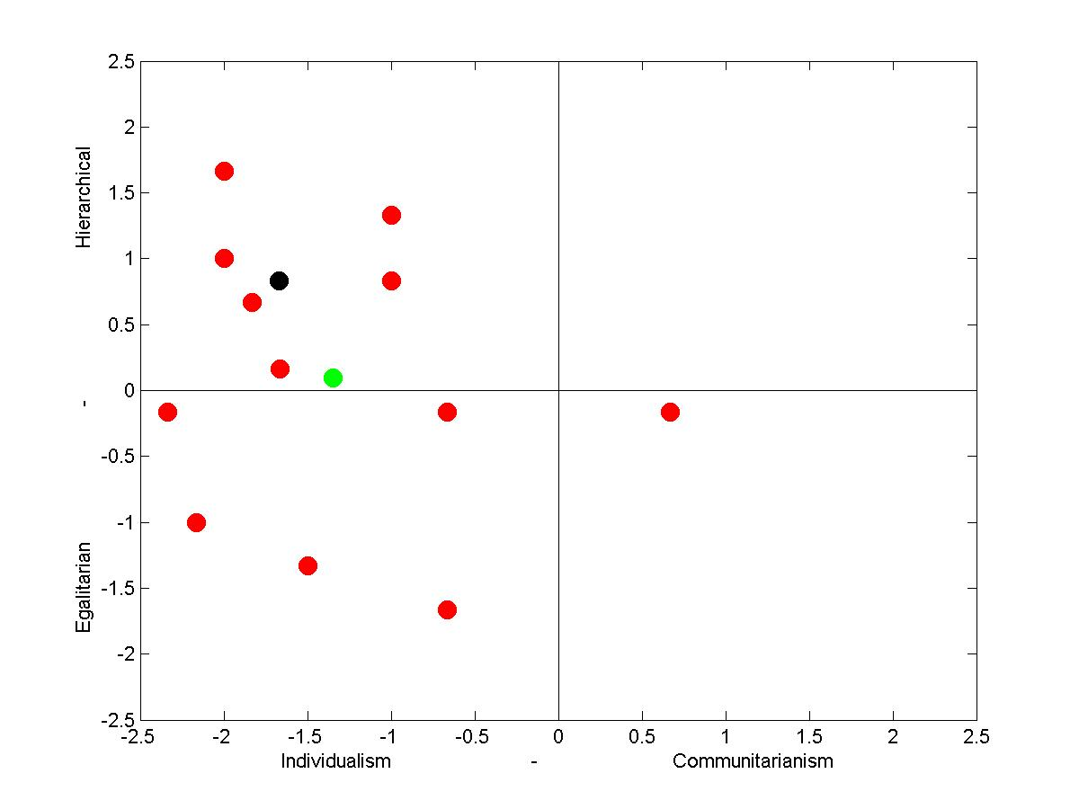
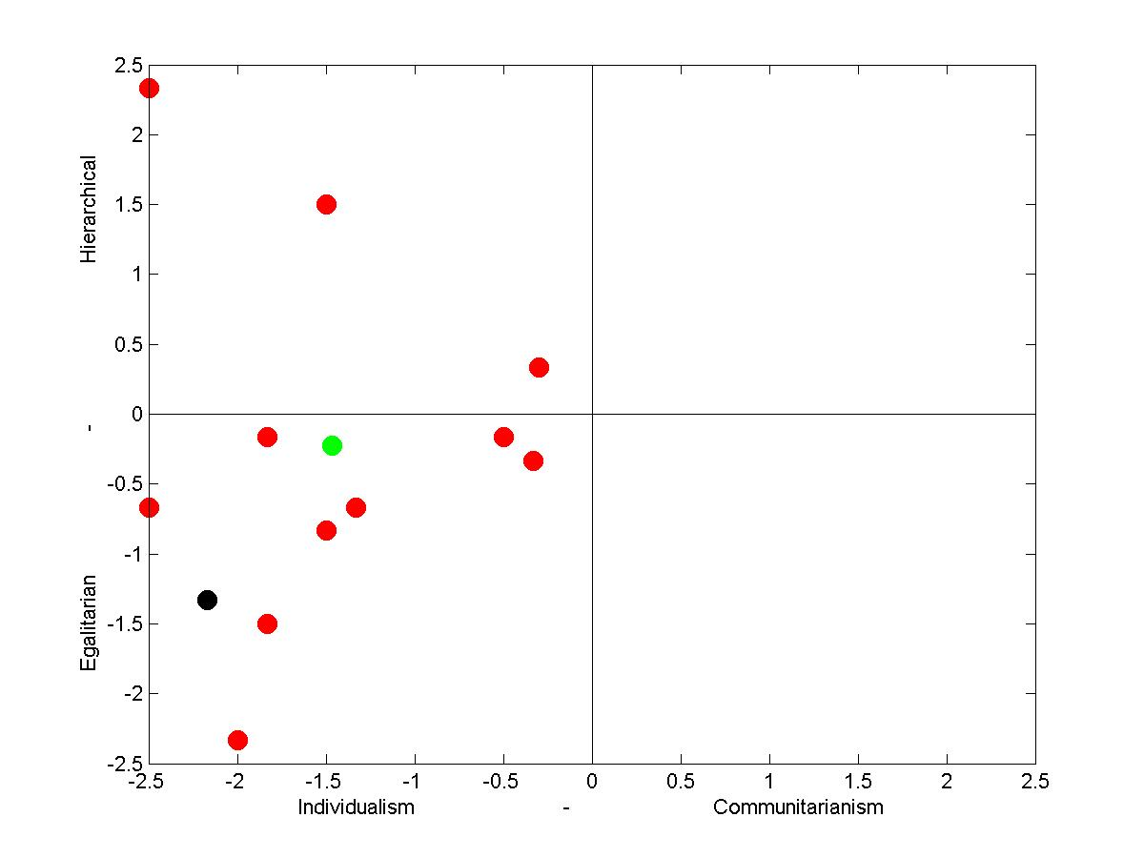
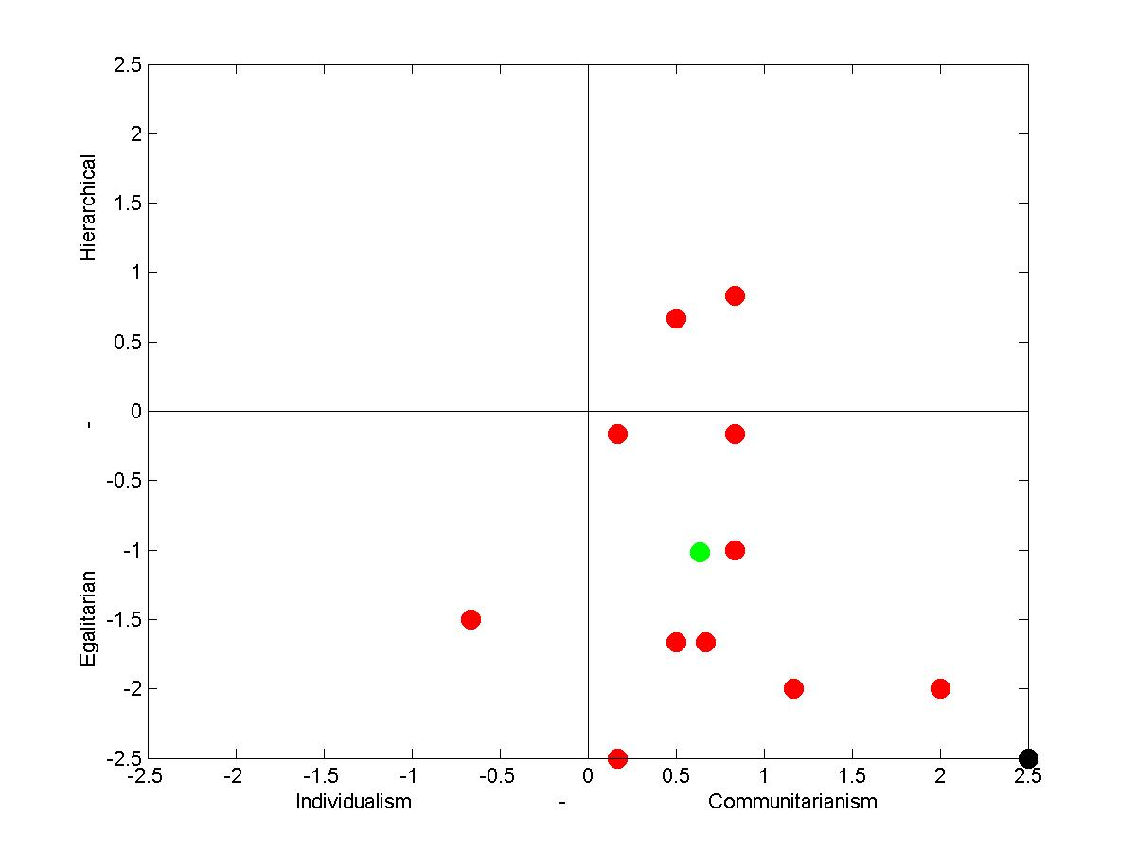
World Views Estimates by AMT workers
Black – original world view from Experiment 1
Red – estimates
Green – mean of estimates

Slide 84
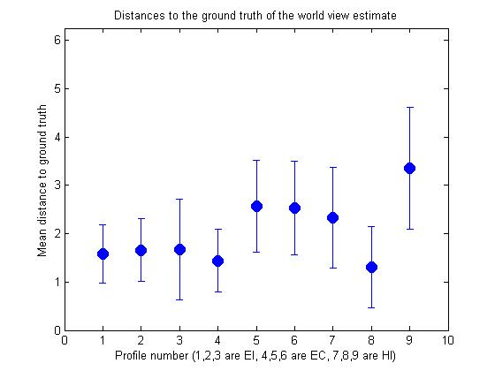
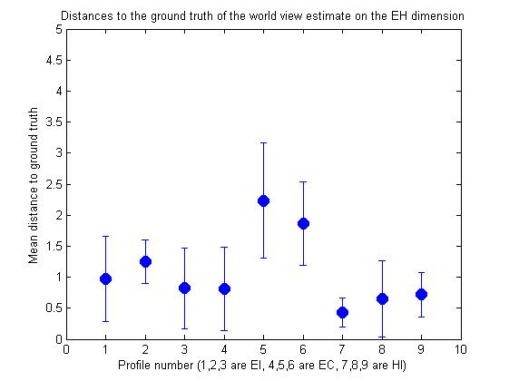
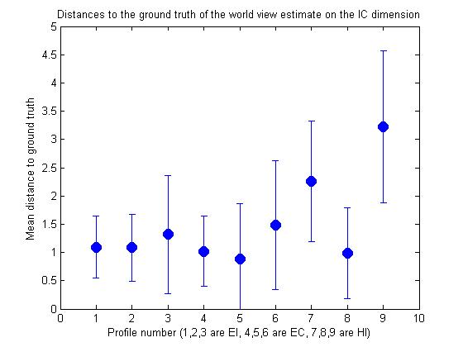
Distance between AMT estimates of world views and original views from Experiment 1

Slide 85
Correctly estimated profile category
Classify Quadrant
Classify EH category
Classify IC category
47%
78%
64%
62%
87%
71%
Notes:
…Insert computer rates

Slide 86
What quadrants classify the profiles
22%
5%
51%
17%

Slide 87
Computers and Humans Performed Similar in Identifying World Views

Slide 88
Work in progress

Slide 89
Does Attaching Charity Profiles to Opinions Affect the Perception of the Opinions?

Slide 90
Research Question (part 3 of 3)
Do profiles we relate to affect how we perceive opinions we agree/don’t agree with?
gun control is necessary guns protect us

Slide 91
Design
2x2x2 design
Reader agrees with opinion presented (or not)
Reader relates to the profile of the author – they are in the same quadrant (or not)
Profiles – have charity information, or explicit opinions

Slide 92
Experiment 1
Participant
Survey World Views
Give Opinion about guns
Read Opinion Piece with Author Profile
Answer Questions
Notes:
Change!!!!!!!!!!!!!!!!

Slide 93
Opinion piece:
We have 306million people in the US. Millions of lives are saved everyday by the private possession of guns, especially pistols. Few die. Once the crook breaks the pane of glass that separates you from him, your gun is the only thing that protects you from him.

Slide 94
Profile:
The government needs to not get involved in making laws to keep people from hurting themselves.
The government interferes far too much in our everyday lives.
Our society would be worse off if the distribution of wealth was more equal.
We have gone too far in pushing equal rights in this country.

Slide 95
Profile
Organization for the Supervision of Gun Ownership
Global Foundation for a Green Lifestyle
Towards an Internet for All
Foundation for Support of Drug Users
Association for Protecting the Citizens Against Guns
Renewable Energy Foundation

Slide 96




Preliminary Trends

Slide 97
More work in progress

Slide 98

What are her world views?
Facebook Profile
Infer World Views from Facebook Profiles

Slide 99



What are her world views?
Photo Profile
Infer if There is An Effect In How Different Photos are Perceived

Slide 100
Longer term future work

Slide 101
Forums Opinion Discussion
Match people by common profiles to discuss something they don’t agree with

Slide 102
Identify what questions one needs to ask in a survey to identify opinions on a certain topic
What type of information to identify for an individual to asses their social views

Slide 103
What profile information is useful to see about authors
For a domain specific question
How do we identify what this information should be?

Slide 104
fin

Slide 105
Awesome People
IIS: Anna, Dimitrios, Pao, Katharina, Ken, Hsiao, Steve
UID: Katrina Panovic, Juho Kim, Eirik Bakke, Max Goldman
Greg Little
CS people: Elaine Angelino, Phillip Guo, Alice Gao,
Varun Kanade, Gregory Malecha
Engineers: Justin Song
Psych&Political Sciences: Jen Skeffington
Sociologists: Mazen Elfakari, Anshul Kumar
Krzysztof Gajos
Margo Seltzer
David Parkes
Stuart Shieber

Slide 109


Polarization from Information Aggregators
republican news aggregator
conservative YouYube

Slide 113
Other reasons
why people read biased information
Habits
Access to information
Trust
Affect
Bias
Culture

Slide 115
Current Experiments
What information could reflect people’s views?
Can we predict world views from certain types of info?
Can people consistently perceive other’s world views?
How would these profiles affect

Slide 116
Experiment 1
What information could reflect people’s views?
Can we predict world views from certain types of info?

Slide 117
Experiment 1
Opinions on debatable topics
What charities would you donate to?\
Goal: Identify items from which we can infer people’s world views

Slide 118
Methodology

Slide 122
Experiment 2
How do people perceive online profiles?

Slide 124
IC score
Principal Component 2
EH score
Principal Component 2

Slide 125
Logistic, Guncontrol, climate, internet, gunowner, nuclear, mean_EH_2bin
=== Stratified cross-validation ===
=== Summary ===
Correctly Classified Instances 67 85.8974 %
Incorrectly Classified Instances 11 14.1026 %

Slide 126
Logistic pc1, … pc11, mean_IC_2bin
=== Summary ===
Correctly Classified Instances 51 65.3846 %
Incorrectly Classified Instances 27 34.6154 %
TP Rate FP Rate Precision Recall F-Measure ROC Area Class
0.723 0.452 0.708 0.723 0.716 0.714 -1.000000
0.548 0.277 0.567 0.548 0.557 0.714 1.000000
Weighted Avg. 0.654 0.382 0.652 0.654 0.653 0.714
=== Confusion Matrix ===
a b <-- classified as
34 13 | a = -1.000000
14 17 | b = 1.000000

Slide 127
Logistic - - pc1,… pc5, mean EH_2bin
=== Summary ===
Correctly Classified Instances 68 87.1795 %
Incorrectly Classified Instances 10 12.8205 %
Kappa statistic 0.6073
Mean absolute error 0.1669
Root mean squared error 0.3088
Relative absolute error 48.2746 %
Root relative squared error 74.6665 %
Total Number of Instances 78
=== Detailed Accuracy By Class ===
TP Rate FP Rate Precision Recall F-Measure ROC Area Class
0.934 0.353 0.905 0.934 0.919 0.893 -1.000000
0.647 0.066 0.733 0.647 0.688 0.893 1.000000
Weighted Avg. 0.872 0.29 0.867 0.872 0.869 0.893
=== Confusion Matrix ===
a b <-- classified as
57 4 | a = -1.000000
6 11 | b = 1.000000

Slide 128

Problem Statement (part 1 of 3)
How/to what extent do online profiles of authors reveal their opinions?

